Slide 1
Law of Large Numbers and the Central Limit Theorem
The LLN and CLT are about convergence of sums of a large # of RVs
LLN is about the “average” (sum / # of RVs)
CLT involves a different normalization (with the sqrt of the # of RVs)
Both are fundamental in probability theory and practice
We first revisit the Chebyshev’s inequality
Then recall regular (calculus) notion of “convergence of sequences”

Slide 2


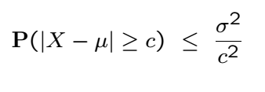
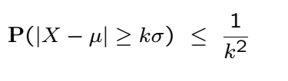

Chebyshev’s Inequality
Find upper bound on tail probabilities of a RV
Finite mean and variance and

Slide 3
Proof

Slide 4
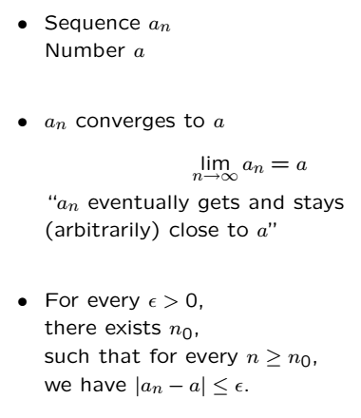
Deterministic Limits

Slide 5
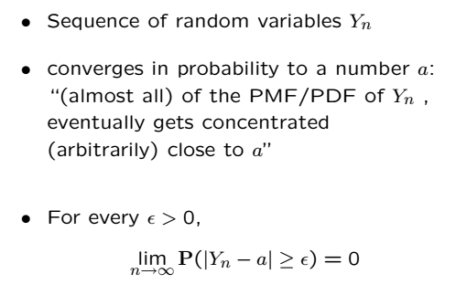
Convergence “in probability”

Slide 6
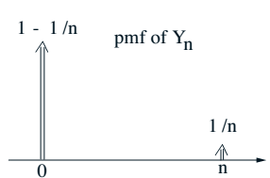


Example
What is ?
Does converge in probability, and if so, to what?
Example of a sequence with constant mean that converges in prob.

Slide 7
Acknowledgements and Citations
Parts of these slides are adapted from the following resources:
Power Point Lecture Slides for the Textbook http://bcs.wiley.com/hebcs/Books?action=index&bcsId=8676&itemId=1118324560
John Tsitsiklis. 6.041 Probabilistic Systems Analysis and Applied Probability, Fall 2010. (Massachusetts Institute of Technology: MIT OpenCourseWare),http://ocw.mit.edu (Accessed 13 Apr, 2015). License: Creative Commons BY-NC-SA

